Slide 1


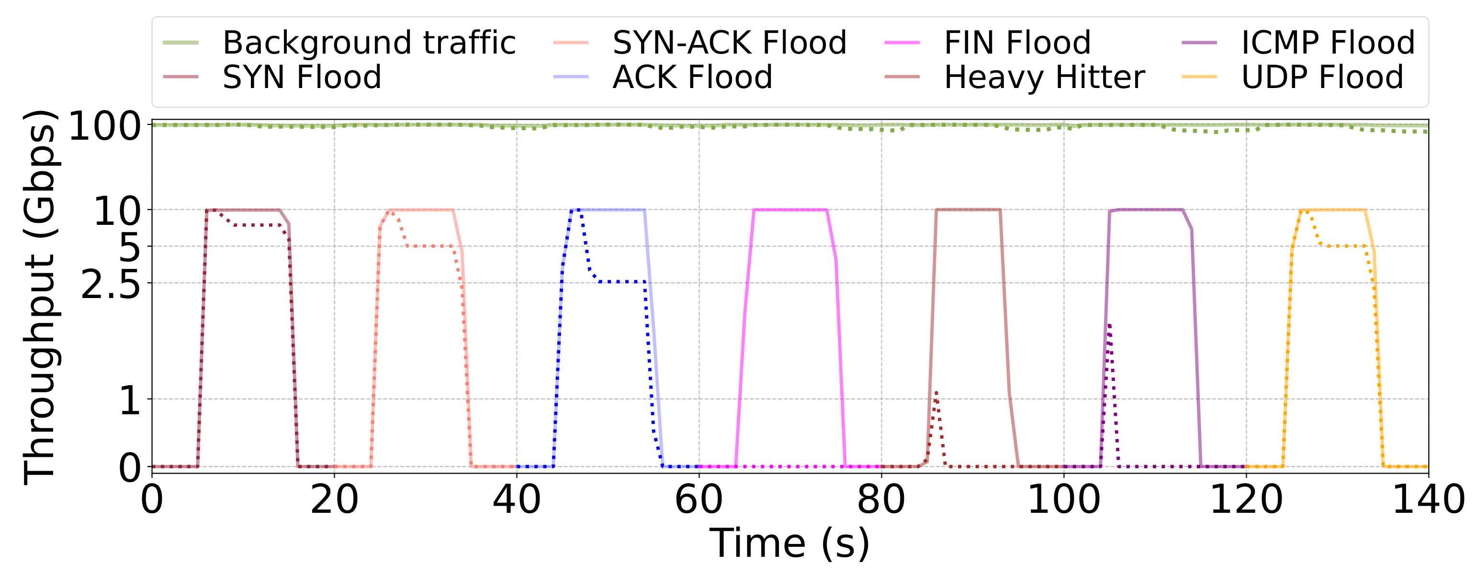
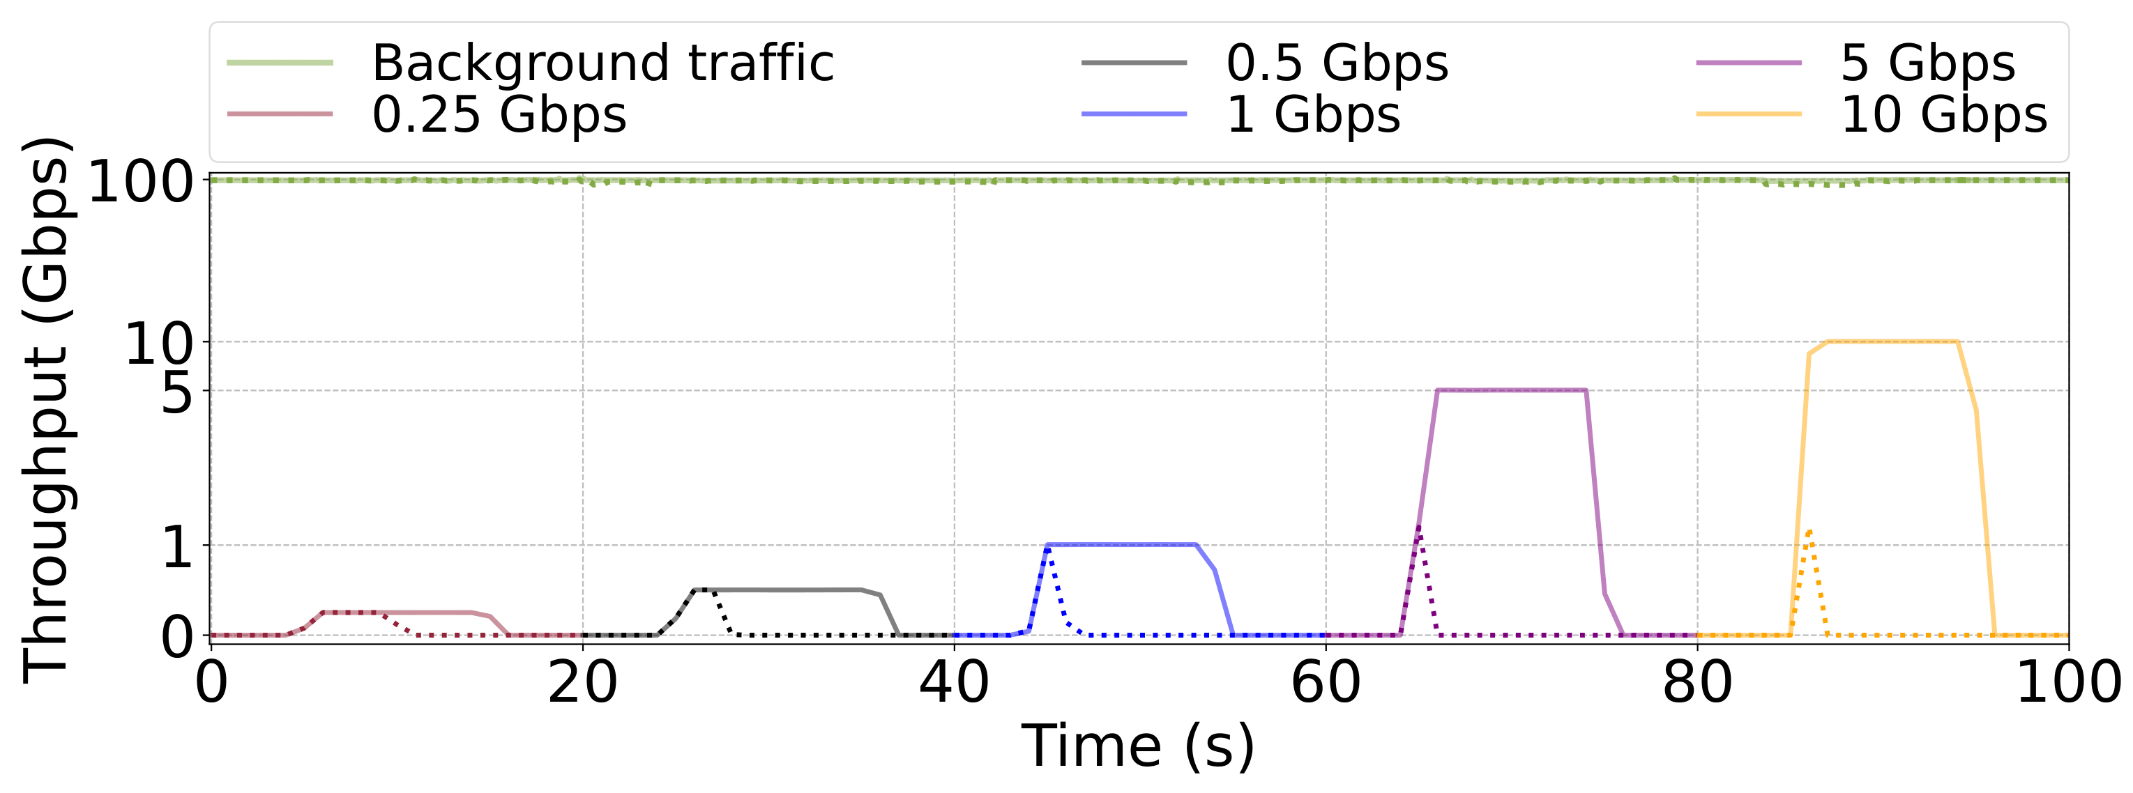
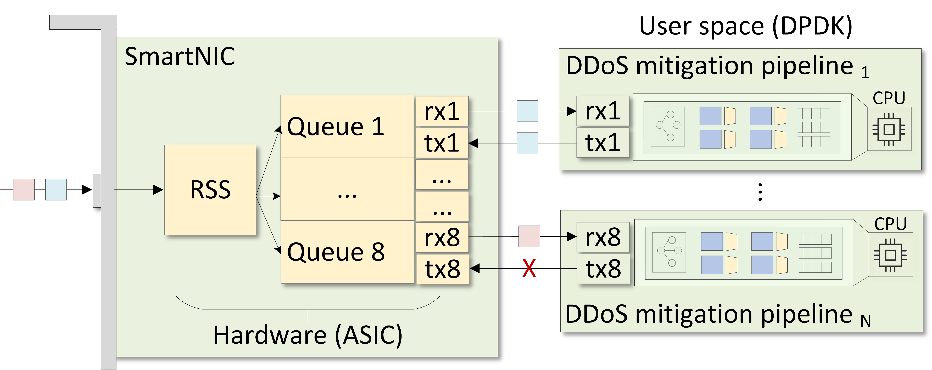
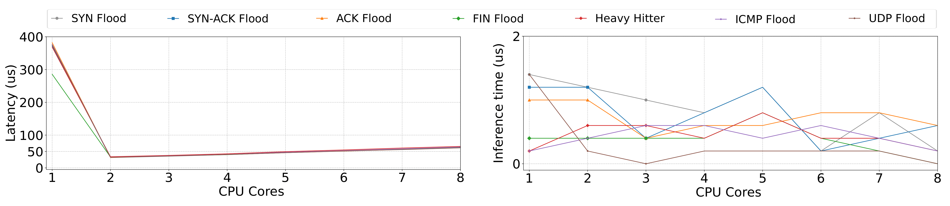
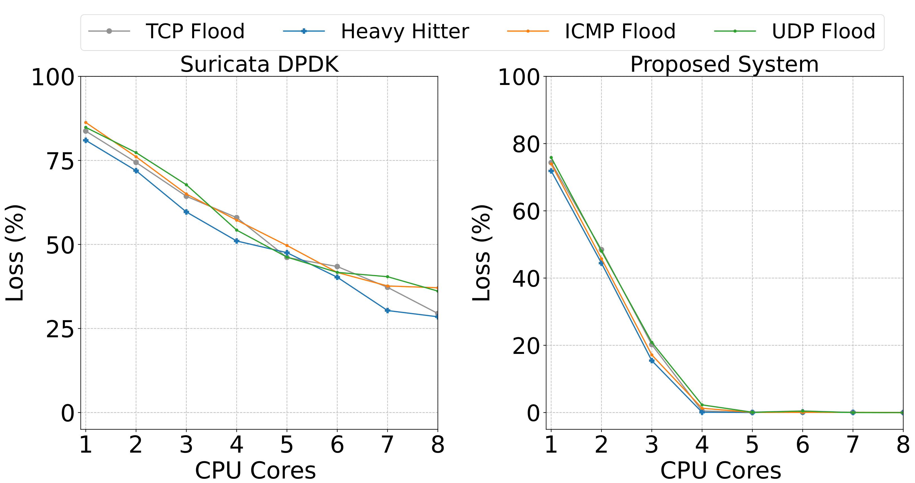
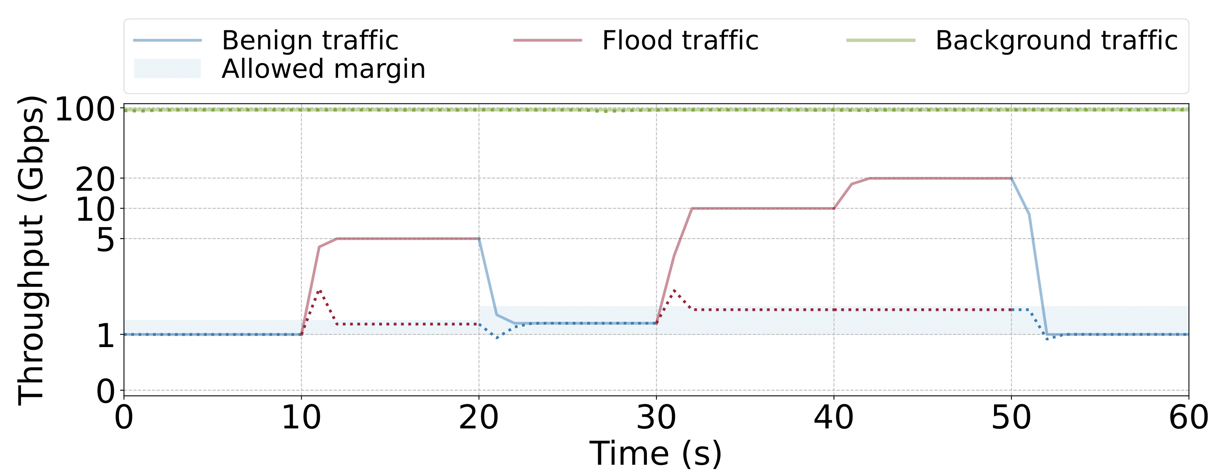
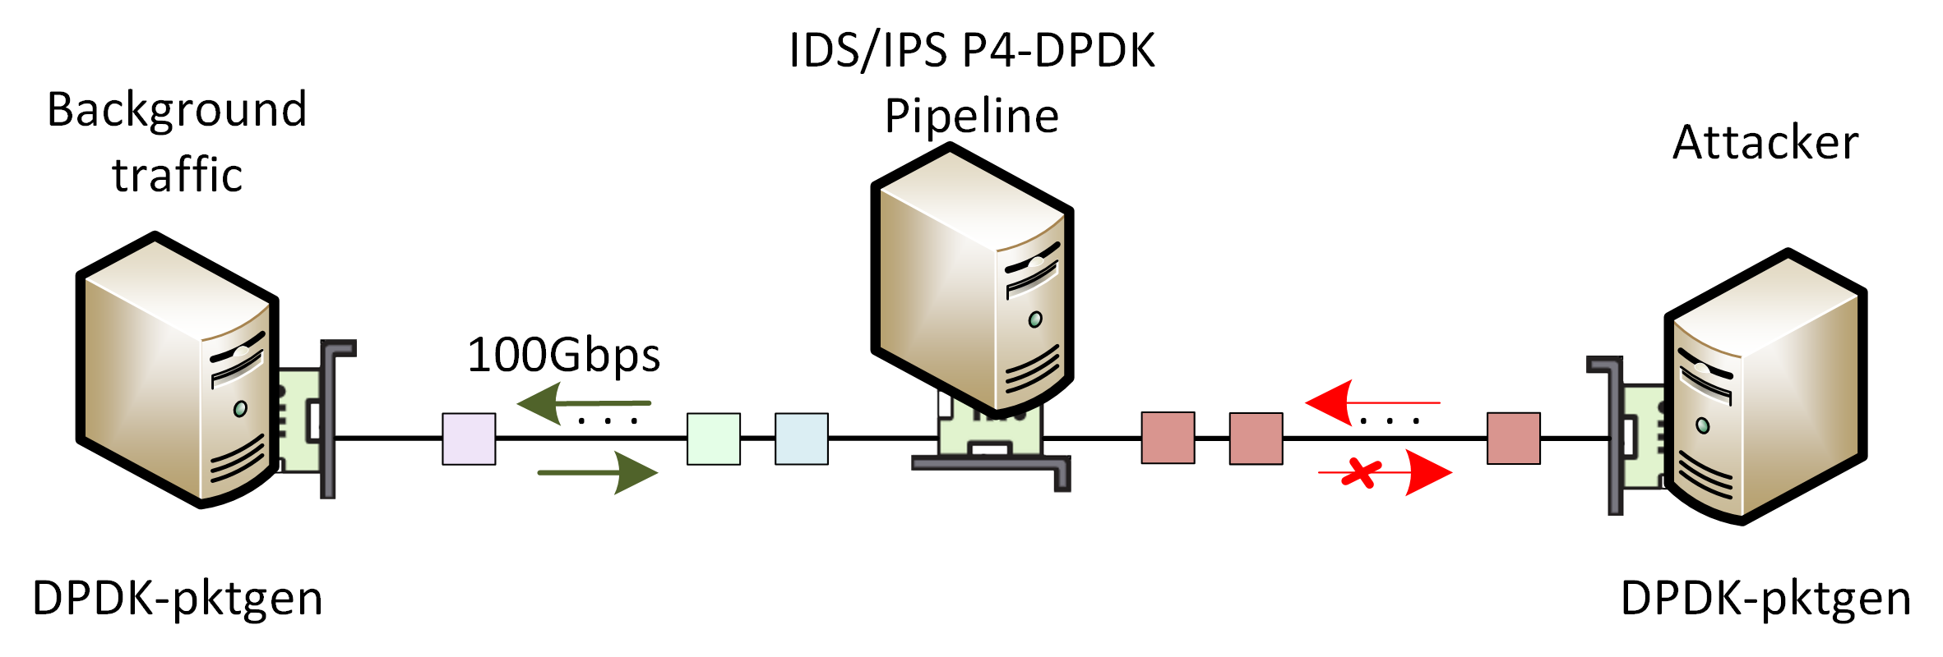
Volumetric DDoS Attack Detection and Mitigation
using P4-DPDK
Samia Choueiri, Ali Mazloum, Sergio Elizalde, Elie Kfoury, Jorge Crichigno
University of South Carolina, Columbia, South Carolina
Abstract
System Architecture
The Effect of DDoS Attack Detection and Mitigation on Background Traffic
Distributed Denial of Service (DDoS) attacks continue to be a major threat to network environments.
Hardware solutions (e.g., programmable data plane switches) offer high performance but require adding hardware, which is not ideal for virtualized environments (e.g., cloud).
Software solutions are flexible but suffer from performance issues due to the packet processing overhead in the OS kernel.
The proposed system implements a DDoS attack detection and mitigation system that leverages the Data Plane Development Kit (DPDK) for high-speed packet processing.
The system integrates a P4-based pipeline for efficient detection and mitigation directly within the data plane.
The system is evaluated in a testbed environment while varying parameters such as the attack volume, the packet size distribution, the CPU core allocations, and others.
The results show that the proposed system effectively detects and mitigates DDoS attacks while maintaining high throughput and low latency, even at a high traffic rate approaching 100Gbps.
The P4 language with the Portable NIC Architecture (PNA) is used to implement the DDoS attack detection algorithm.
The DPDK pipeline is compiled and loaded on the CPU cores of the host.
The SmartNIC uses Receive Side Scaling (RSS) to distribute the load across the pipelines in the CPU cores.
The experiments evaluate the ability of the pipeline to detect and mitigate different types of DDoS attacks in the presence of high-rate traffic.
The system promptly mitigated the detected attack even while 100Gbps of background traffic was processed by the pipeline using four CPU cores.
The seven different attacks are detected and mitigated with multiple approaches.
Detection and mitigation of simultaneous DDoS attacks
Detection and mitigation of heavy hitters from different flows and rates
P4-DPDK DDoS attack detection system architecture
The Overall Latency and Inference Time in the P4-DPDK Pipeline
Related Work
Methodology
The latency is measured as the lifetime of legitimate packets as they reach the NIC, undergo processing in the pipeline, and leave the NIC.
The inference time is the time the system takes to detect an attack in any of the operating pipelines.
The latency and inference time measurements are collected as the pipeline processes the legitimate flows while it mitigates the different attacks.
DDoS defenses over P4 programmable data planes:
Existing approaches typically use probabilistic data structures to track flows' statistics at scale such as MV-Sketch [1], POSEIDON [2], and Jaqen [3]. They require networks to upgrade their infrastructure, which results in cost and complexity.
DDoS defenses over DPDK:
Using DPDK, significant performance gains have been shown in DDoS applications [4,5]. They are implemented in a general-purpose programming language lacking the flexibility of P4.
[1] Tang et. al., “A fast and compact invertible sketch for network-wide heavy flow detection,” 2020.
[2] Zhang et. al., “Poseidon: mitigating volumetric DDoS attacks with programmable switches,” 2020
[3] Liu et. al., “Jaqen: A {High-Performance}{Switch-Native} approach for detecting and mitigating volumetric {DDoS} attacks with programmable switches,” 2021
[4] Basat et. al., “Volumetric hierarchical heavy hitters,” 2018
[5] Scherrer et. al., “LOFT: an efficient and scalable algorithm for detecting overuse flows,” 2021
List of considered DDoS attacks:
DDoS attack detection methods:
Total packet count thresholding using register counters.
Per-flow packet count monitoring using the Count-min Sketch (CMS) data structure.
Connection tracking using the add-on-miss match-action tables.
DDoS attack mitigation methods:
Reducing the number of processed packets by a certain level.
Blacklisting flows identified as attackers.
Blocking flows that do not belong to a previously established connection.
1. SYN flood | 2. SYN-ACK flood | 3. ACK flood
4. FIN/RST flood | 5. Heavy hitter | 6. ICMP flood
7. UDP flood
Latency vs. the number of CPU cores.
Inference time vs. the number of CPU cores.
Packet-loss in P4-DPDK vs. Suricata-DPDK
Dynamic Thresholding
The packet loss of the proposed system is compared against the packet loss in Suricata which is a widely used network IDS/IPS.
Suricata can be scaled to run on multiple CPU cores and is able to leverage DPDK for acceleration and kernel bypass.
The system detects the normal behavior of the network and calculates the allowed margin of throughput.
An attack is identified based on the ratio between the allowed margin and the last observed number of packets.
As a flood attack is detected, the system processes an amount of packets within the allowed margin.
As the end of an attack is detected, the system updates the considered normal behavior.
Experiment Topology
Conclusion and Lessons Learned
The Intrusion Detection System (IDS) / Intrusion Prevention System (IPS) also reflects the processed packets.
The attacker simulated seven different DDoS attacks.
All servers are on the same FABRIC site.
DPDK-pktgen is used to generate traffic.
Detecting all attacks is effective, even in the presence of background traffic with high rates (up to 100Gbps).
Increasing the number of CPU cores improves throughput and prevents packet loss while the latency is slightly affected.
Using four pipelines is a balanced configuration that allows the system to scale while maintaining performance.
Acknowledgement
Experiment topology
This work was supported by the National Science Foundation (NSF), Award 2346726, 2417823, and 2403360.
Packet loss in Suricata-DPDK and the proposed system while mitigating DDoS attacks.
Detection and mitigation of a flood attack without predefined thresholds and drop rates

